Slide 1
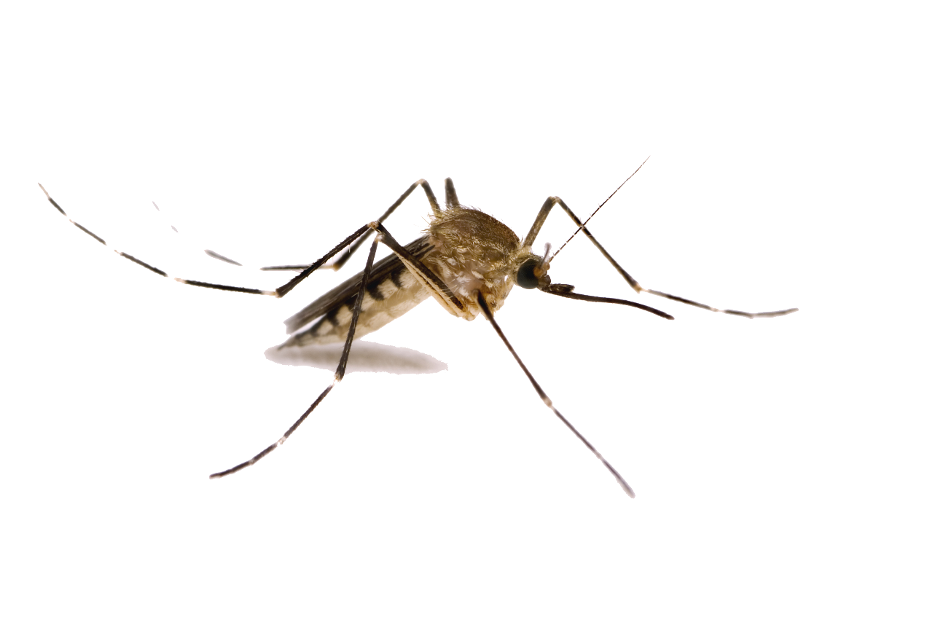

Epidemic outbreak prediction using artificial intelligence
Team Lead - Prof. Joinal Ahmed
Team members
Mr. Zahoor
Mr. Soham
Ms. Ashlesha

Slide 2

PROBLEM STATEMENT
COVID19 has shown the real face of our healthcare infrastructure, planning, and readiness to address a pandemic with limited resources, unprepared staff, and broken supply chains. Government agencies if provided with this information well in advance, can plan and execute them in a well-orchestrated manner optimizing the use of staff, resources at their disposal. In this project, we aim is to analyze and build a multimodal model to predict the likelihood of an area having an outbreak.

Slide 3

ZIKA VIRUS
Zika virus is a mosquito-borne flavivirus that was first identified in Uganda in 1947 in monkeys. It was later identified in humans in 1952 in Uganda and the United Republic of Tanzania.
In March 2015, Brazil reported a large outbreak of rash illness, soon identified as Zika virus infection.
Zika virus is primarily transmitted by the bite of an infected mosquito from the Aedes genus, mainly Aedes aegypti, in tropical and subtropical regions. Aedes mosquitoes usually bite during the day, peaking during early morning and late afternoon/evening.
Zika virus is also transmitted from mother to fetus during pregnancy, through sexual contact, transfusion of blood and blood products, and organ transplantation.

Slide 4
DATA EXTRACTION
Zika Virus
Weather
Population density

Slide 5







Weather
Population
Density
Argentina
United States
Brazil
Colombia
Dominican Republic
Ecuador
El Salvador
Guatemala
Haiti
Mexico
Nicaragua
Panama
Puerto Rico
U.S. Virgin Islands.
2016 - 2018

Slide 6
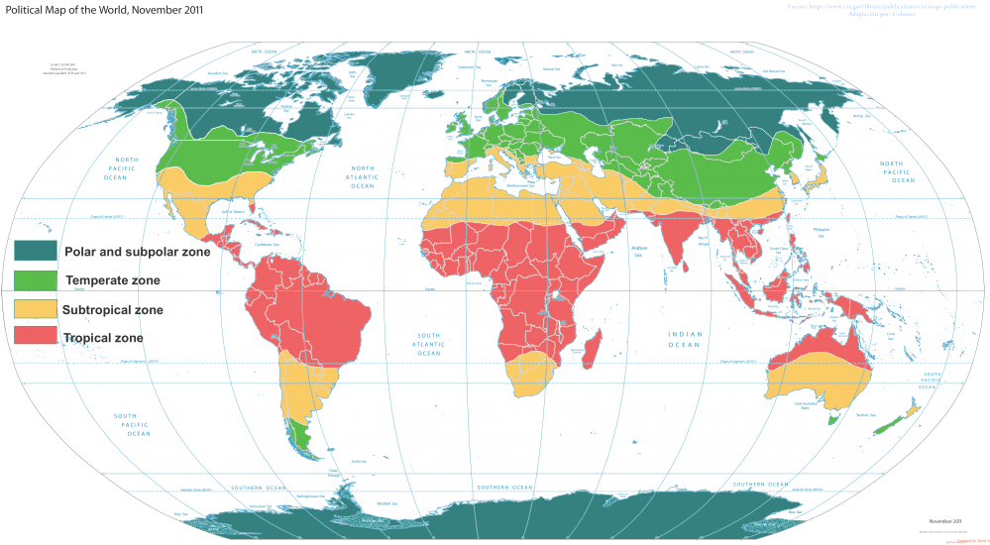
WEATHER
Tropical zone
Summer season temperatures average about 77 degrees
Dry season temperatures average about 68 degrees
Precipitation only falls during the summer months, usually from may-august with June and July having the heaviest rain
Subtropical zone
Humid summers and mild winters
Summer, the average temperature is between 70 and 80 degrees
Coldest month usually averages 45-50 degrees
Rain falls throughout the year.
There are 9/10 days with rainfall per month from October to April.

Slide 7
EXPLORATORY DATA ANALYSIS

Slide 8
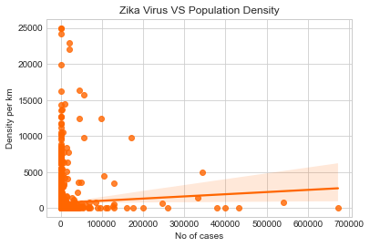
POPULATION DENSITY
Country | No. of cases | Density
Panama Metro Las_Garzas | 9389432 | 1966.26
United States Puerto Rico | 19 | 24970.13

Slide 9
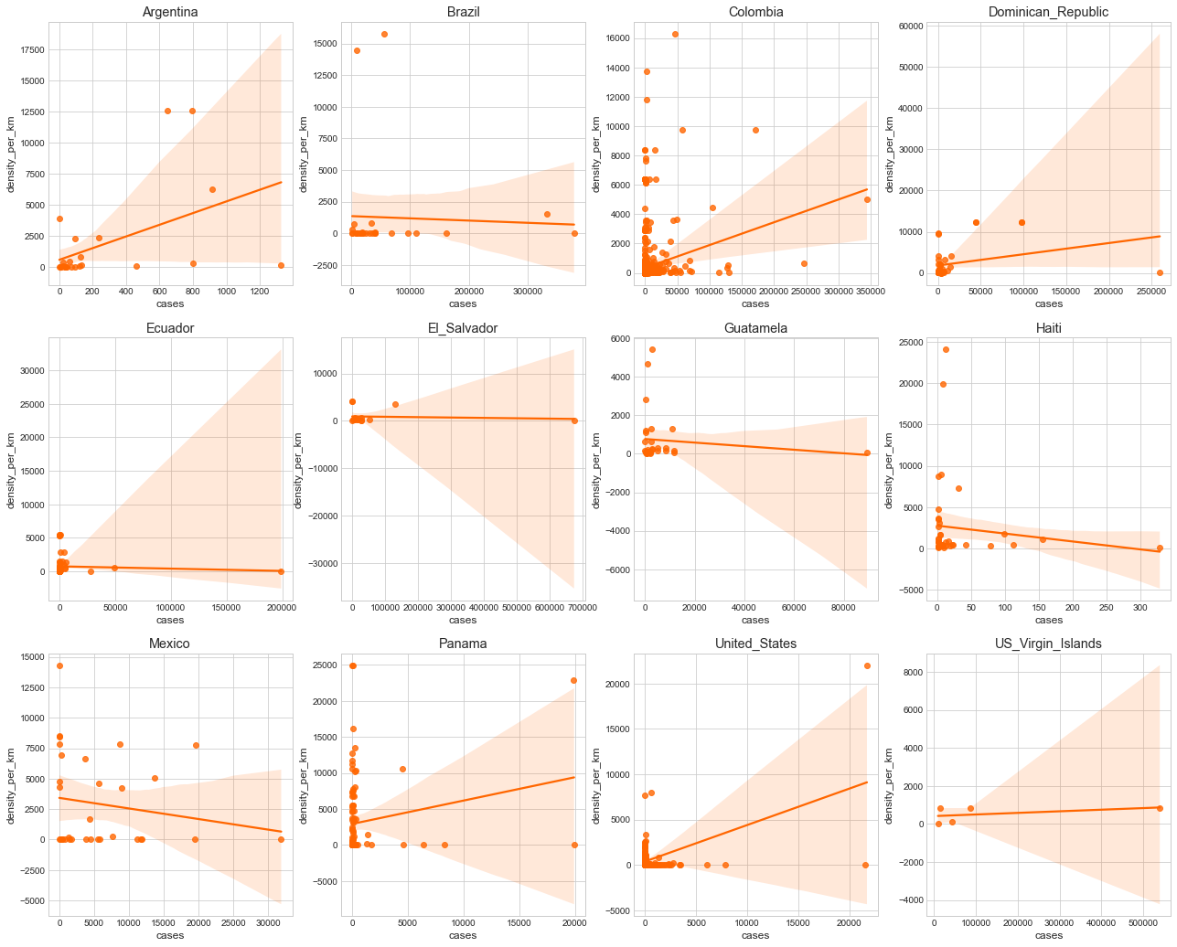
POPULATION DENSITY

Slide 10
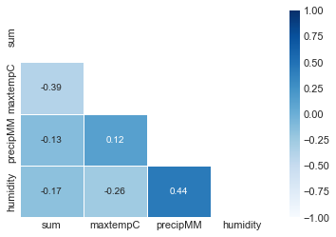
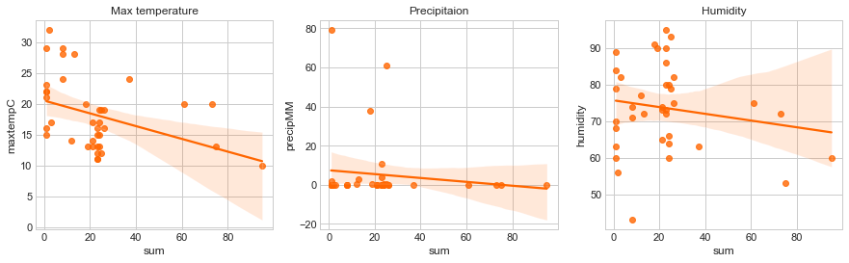
WEATHER SUB-TROPICAL REGION
Argentina

Slide 11
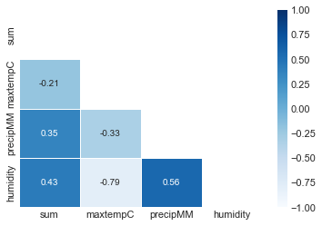
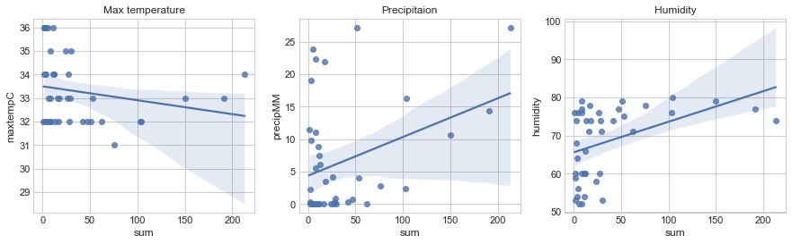
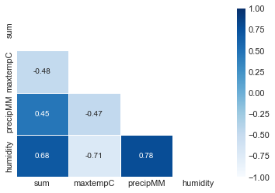
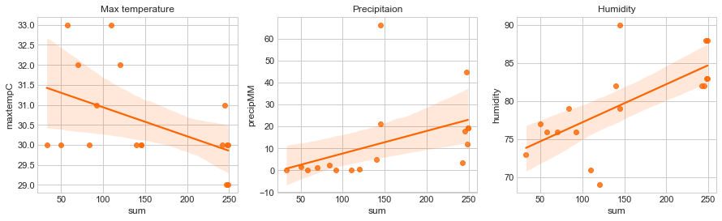
WEATHER TROPICAL REGION
Nicaragua
Panama

Slide 12
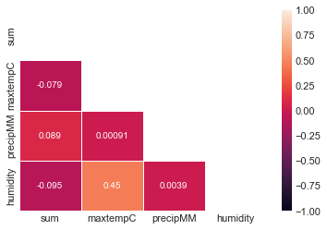
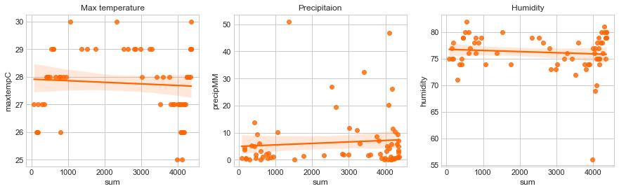
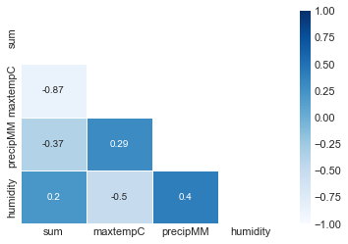
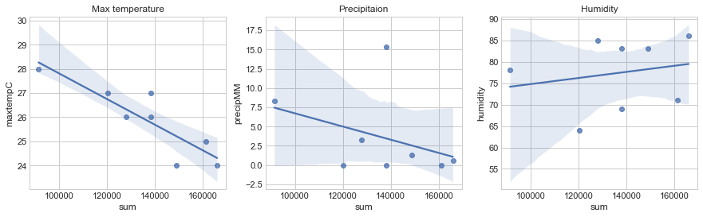
WEATHER TROPICAL REGION
Virgin Islands
Brazil

Slide 13
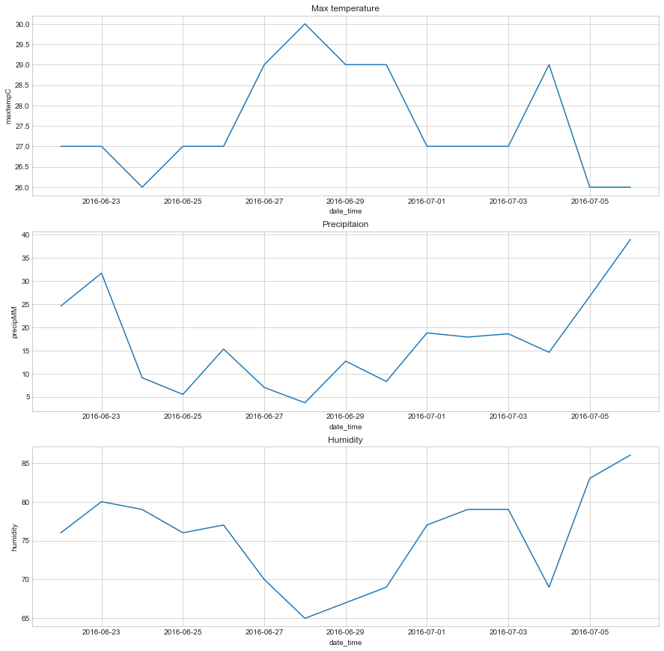
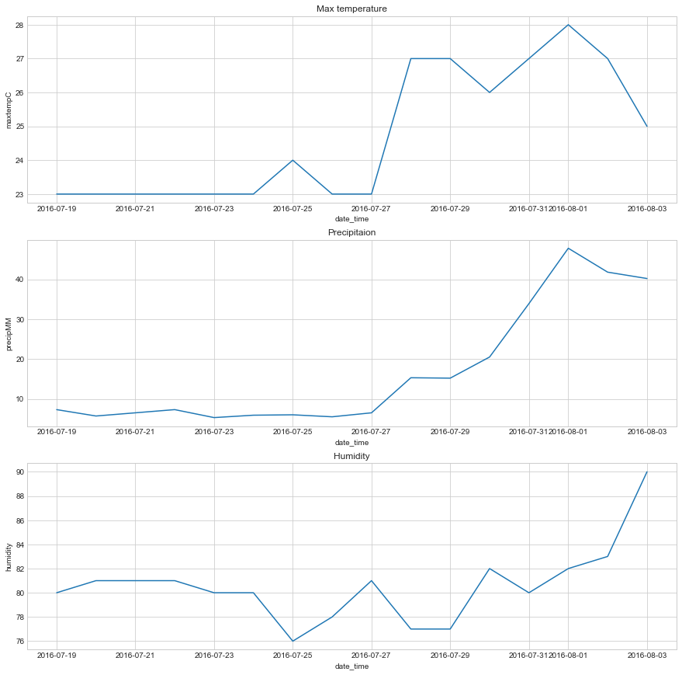
WEATHER With incubation period
United states - Florida
Case 1
Report date - 2016-07-06 = 0
weather date - 2016-06-22 to 2016-07-06
Case 2
Report date - 2016-08-03 = 6
weather date - 2016-07-19 to 2016-08-03

Slide 14
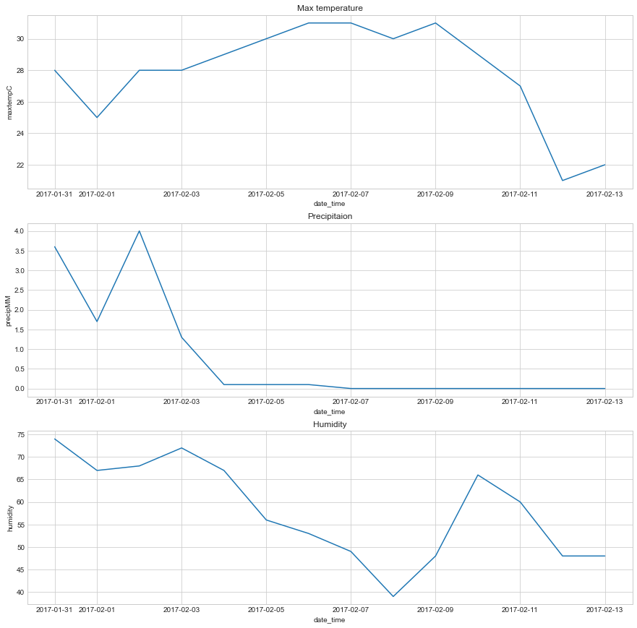
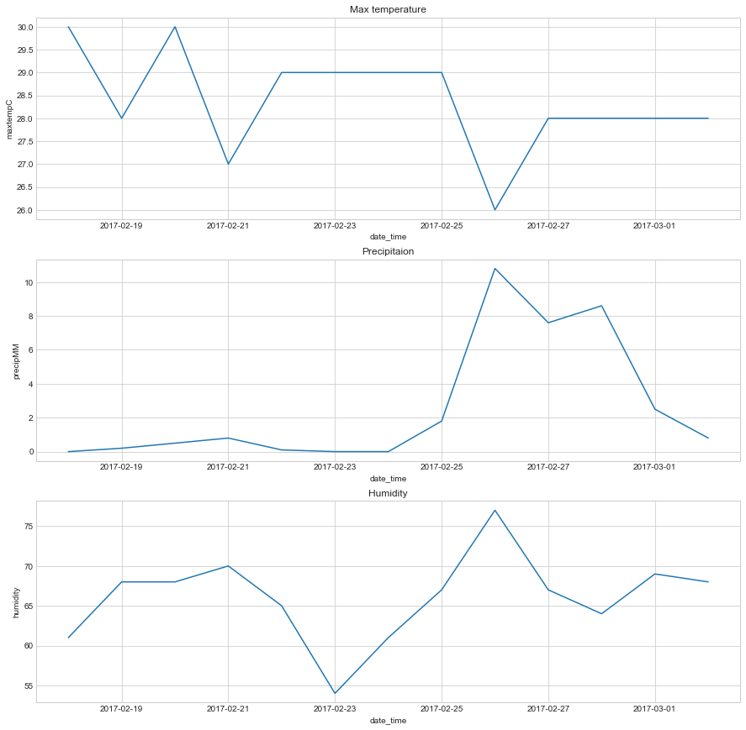
WEATHER With incubation period
Case 3
Report date - 2017-02-13 = 214
weather date - 2017-01-31 to 2017-02-13
Case 4
Report date - 2017-03-02 = 24
weather date - 2017-02-18 to 2017-03-02

Slide 15
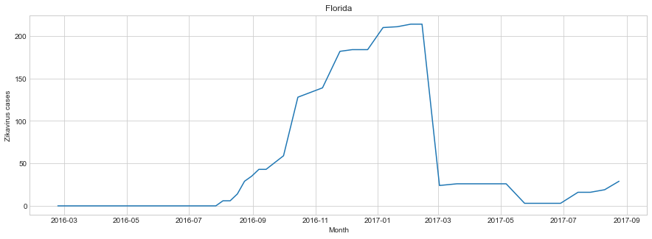
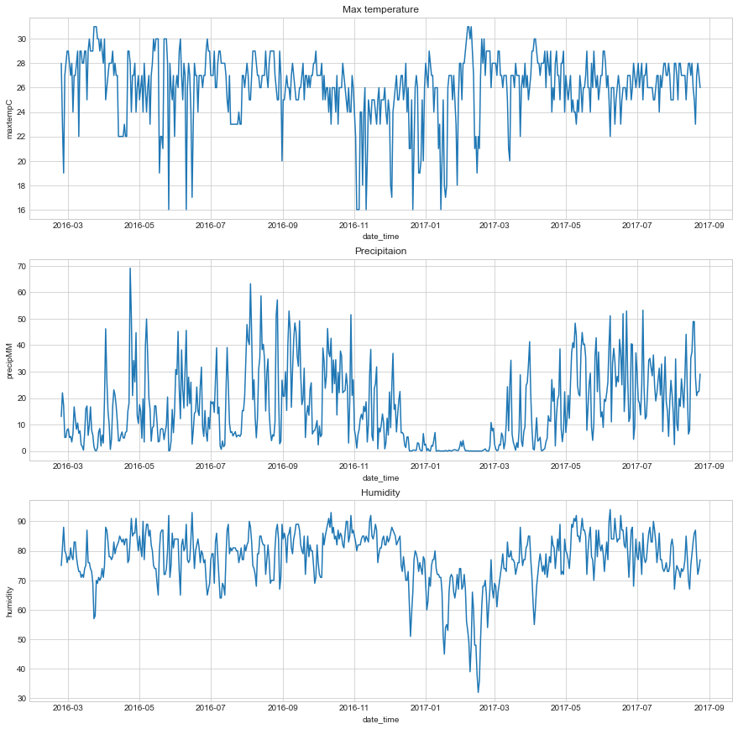
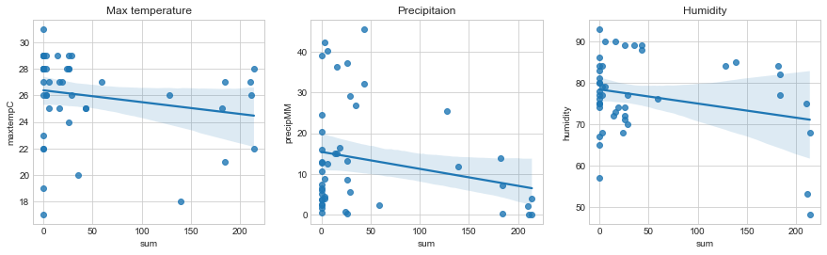
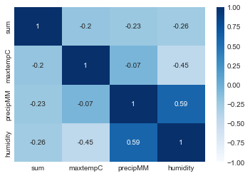

Slide 16
INSIGHTS
Zika Virus Cases vs Population Density:
There is no certain relation between number of cases and population density of a certain area
For some regions, number of cases are high and population density is low while for other regions, number of cases are low and population density is high.
Zika Virus Cases vs Weather:
For subtropical regions, number of cases are affected by sudden changes in weather.
For tropical regions, number of cases are affected by the commencement of monsoon season.
Precipitation and humidity play an important part in the variance of number of Zikavirus cases.

